Slide 1

EARTHQUAKE ALERT PREDICTION ANALYSIS
RAAGA VARSHA. B
Email: Raagavarsha@gmail.com Linkedin: https://www.linkedin.com/in/raaga-varsha-2a4834310/ phone:+91 9392544570

Slide 2
INTRODUCTION
Earthquakes are among the most destructive natural disasters.
Predicting their impact can help minimize damage and improve safety.
This study analyzes earthquake data to uncover patterns related to magnitude, depth, and alert levels.
Visual analysis provides insight into the factors influencing earthquake severity and alert classification.

Slide 3
OBJEctive
Analyze patterns in earthquake data.
Study the relationship between magnitude, depth, and alert level.
Visualize key trends for better understanding and preparedness.
Derive insights that can support future predictive modeling.

Slide 4
Dataset Overview
Dataset Name: Earthquake Alert Balanced Dataset
Attributes:
Magnitude
Depth (km)
Latitude & Longitude
Alert (Green / Yellow / Orange / Red)
Time and Place of occurrence
Balanced dataset ensures unbiased alert-level representation.

Slide 5
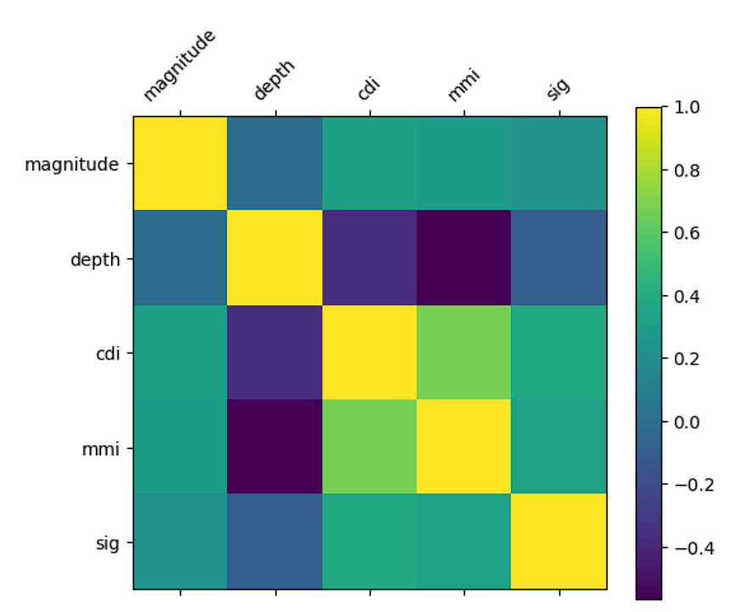
Data Analysis Performed
Cleaned and validated data for consistency.
Conducted distribution analysis of magnitude and depth.
Studied correlation between magnitude, depth, and alert levels.
Used Matplotlib for clear visualizations.

Slide 6
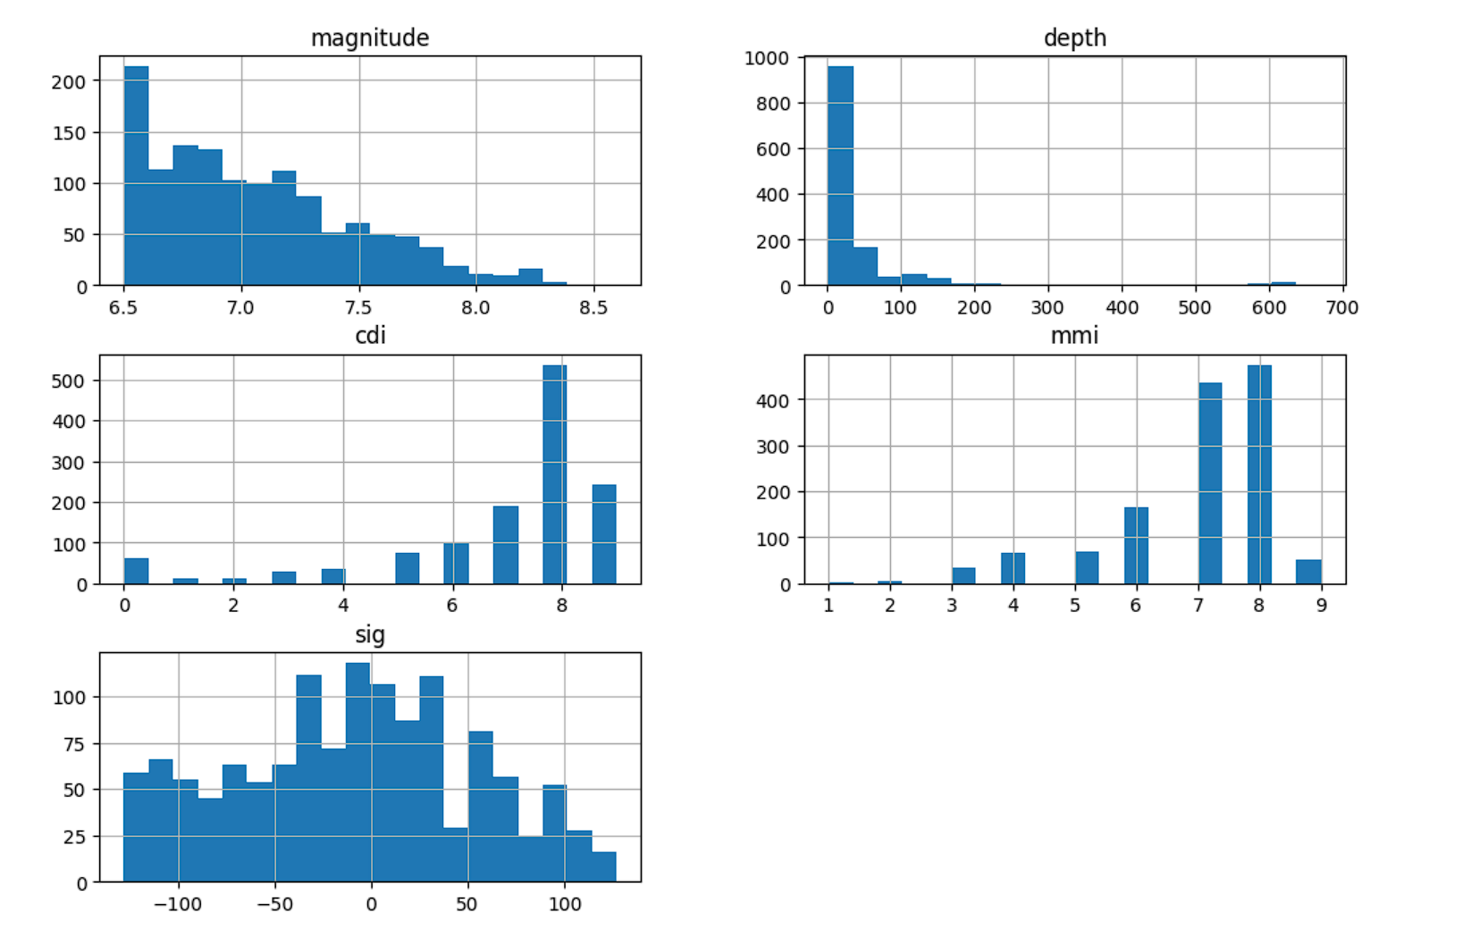
Visual Insights
Graphs showed increasing alert levels with higher magnitudes.
Shallow earthquakes caused higher alerts than deep ones.
Geographic plots revealed regions of frequent high-magnitude quakes.

Slide 7
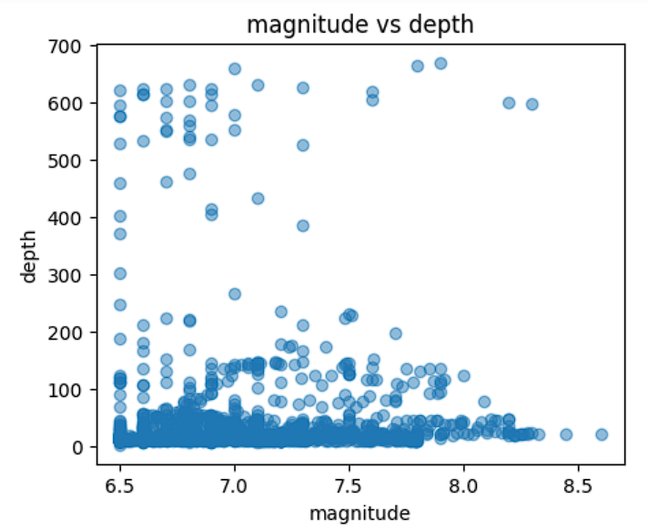
Key Findings
Magnitude strongly influences alert severity.
Depth has an inverse correlation with damage impact.
Dataset displays balanced representation across all alert categories.
Identifiable clusters suggest predictable seismic activity regions.

Slide 8
Conclusion
Clear relationship between magnitude, depth, and alert level.
Visualization effectively highlights earthquake severity trends.
Findings can support disaster preparedness and early alert systems.

